Slide 1

Tom the IEP Assistant
Created by Thomas Braccia For Microsoft Azure Hack for Accessibility 2021

Slide 2
The challenge Tom was built to solve
“Build an application prototype with Azure for and with people with disabilities in the context of education. The application should be functional with real or sample data”
Tom was built for students with disabilities by ensuring they have an equal right to an education especially now that the Education System is in a period of large changes due to the Covid-19 Pandemic making it easier for students to be left behind. In addition it was developed with them as it was not only inspired by students with disabilities and their struggles but I also received feedback from them and their families.

Slide 3
Background
An Individualized Education Plan (IEP) is a map of the special services a student needs to succeed with their disability.
As of 2018-19 14% of all US students were on an IEP.
So long as schools were still open during the COVID-19 pandemic (including remote learning) they are required to still serve students with IEPs. However, many schools struggled to properly do this.

Slide 4
Introduction
Tom is an Azure Bot that was created in order to assist both students and guardians of students with creating a new IEP and ensuring existing ones are being followed.
Fun Fact: Tom is named after former Iowa Senator Tom Harkin who introduced the Individuals with Disabilities Education Act.

Slide 5
Inspiration and feedback from the community
Tom was inspired by my mother’s (a special needs educators) increased frustration and concern for her students when schools were not properly following their IEPs at the start of the COVID-19 pandemic leaving students with disabilities left behind. In addition, Tom supports setting up an IEP as my mother also explained the challenges many families go through with setting up an IEP for their child.
My mother also put me in touch with some of her clients and their families to get their feedback while I was working on Tom.

Slide 6
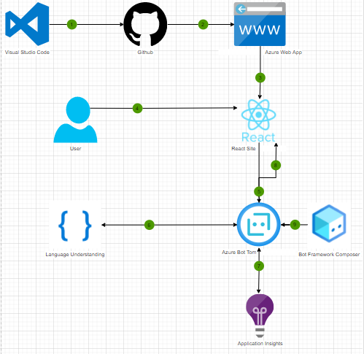
Built With:
Tom was built with Bot Composer Framework to deploy an Azure Bot.
The bot is accessible from a Create React App that is hosted with an Azure Web App.
Tom utilizes Application Insights for improving development.
Tom utilizes Language Understanding (LUIS) for understanding the user and responding to them correctly.

Slide 7
Demo

Slide 8
Challenges faced while building Tom
Finding time to work on Tom between being a full-time student, part-time intern, and heavily involved in the university as midterms approached.
Deploying Tom to Azure was challenging due to account restraints and numerous missing features in Bot Composer Framework requiring me to pull down contributors branches.
An avoidable challenge was I reinvented the wheel when building the url cleansing for the generating the emails for the user in JS versus using a package.
Following an iterative approach (in order to incorporate feedback from my mother’s clients) with a limited timeline.

Slide 9
What is next for Tom
Add chat bot features for correcting things such as somebody’s name or email (this was not added solely based on time constraints).
Add more questions for the user to generate a better email:
Why the students needs or has an IEP, pronouns of the student, name of the school, name of the teacher if they are reaching out to a different faculty member.
Add a connection to a list of Education Advocates and Attorneys to recommend ones that are close to the user if needed.

Slide 10
Sources:
Braccia, Thomas, and Ann Braccia. “Special Needs Educator and IEPs During Covid-19.” 22 Feb. 2021.
Braccia, Thomas, and the Tidwell Family. “Special Needs Education and IEPs During Covid-19.” 24 Feb. 2021.
Braccia, Thomas, and Hayley’s Family “Special Needs Education and IEPs During Covid-19.” 28 Feb. 2021.
https://nces.ed.gov/programs/coe/indicator_cgg.asp
https://www.understood.org/en/school-learning/special-education-coronavirus-faqs
https://www.education.ne.gov/sped/
https://www2.ed.gov/about/offices/list/ocr/frontpage/faq/rr/policyguidance/Supple%20Fact%20Sheet%203.21.20%20FINAL.pdf
https://www.ncsecs.org/news/covid-19-and-students-with-disabilities/
https://now.tufts.edu/articles/how-covid-19-has-affected-special-education-students
https://www2.ed.gov/about/offices/list/ocr/504faq.html
https://www2.ed.gov/about/offices/list/ocr/docs/504-resource-guide-201612.pdf
https://www2.ed.gov/parents/needs/speced/iepguide/index.html

